Slide 1
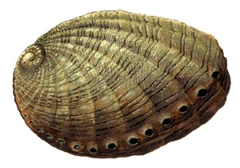
Classification of the gender and age of Abalones from their physical measurements
ANISH GUPTA
JOHN SANJEEVI
SADHASHIVA

Slide 2
Description of Dataset
The data set is obtained from UCI Machine Learning Repository
The data set contains physical measurements of 4177 abalones
Train our model with 66.0%(2600) observations and test with rest

Slide 3
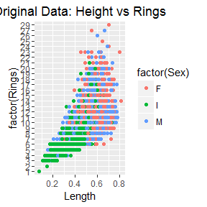
Description of Dataset
There are nine variables we considered
Length
Diameter
Height
Whole weight
Shucked weight
Viscera weight
Shell weight
Rings

Slide 4
Our project
Classification based on several models
Used different exploratory analysis
Used different programming languages
Find the best model to classify the Abalone dataset

Slide 5
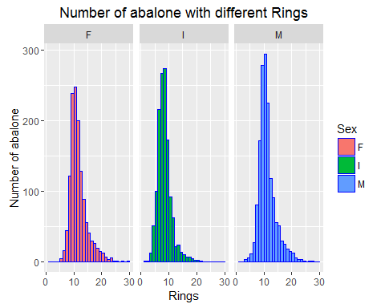
Classify Data According to Age

Slide 6
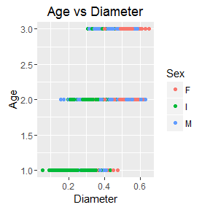
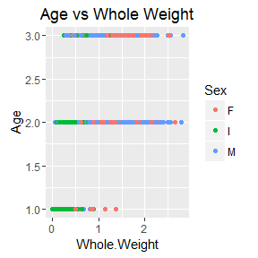
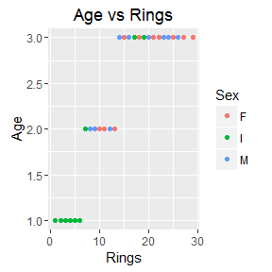
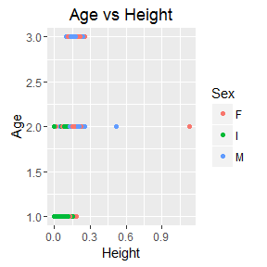
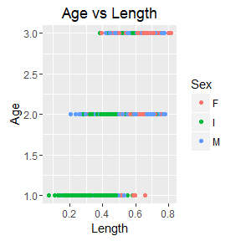
Classify Data According to Age and Gender

Slide 7
Classification using SVM on Age
Accuracy – 55.2817
Confusion Matrix
a b c <-- classified as
102 41 0 | a = A
8 1 108 0 | b = B
0 29 132 | c = C

Slide 8
Classification using SVM on Gender
Accuracy – 82.0423
Confusion Matrix
a b c <-- classified as
413 0 106 | a = M
371 0 82 | b = F
68 0 380 | c = I

Slide 9
Classification using Naïve Bayes based on Age
Accuracy – 78.5915
Confusion Matrix:
a b c <-- classified as
130 13 0 | a = A
122 851 143 | b = B
0 31 130 | c = C

Slide 10
Classification using Naïve Bayes based on Gender
Accuracy – 52.5352
Confusion Matrix:
a b c <-- classified as
60 340 119 | a = M
46 317 90 | b = F
25 54 369 | c = I

Slide 11
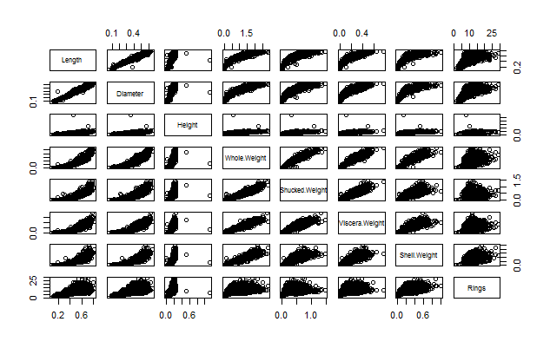
Exploratory Data Analysis

Slide 12
Correlations in Abalone Dataset
## Length Diameter Height Whole.Weight Shucked.Weight ## Length 1.0000000 0.9868132 0.8275521 0.9252551 0.8979052 ## Diameter 0.9868132 1.0000000 0.8337053 0.9254520 0.8931591 ## Height 0.8275521 0.8337053 1.0000000 0.8192087 0.7749568 ## Whole.Weight 0.9252551 0.9254520 0.8192087 1.0000000 0.9694027 ## Shucked.Weight 0.8979052 0.8931591 0.7749568 0.9694027 1.0000000 ## Viscera.Weight 0.9030105 0.8997262 0.7982929 0.9663721 0.9319557 ## Shell.Weight 0.8976970 0.9053281 0.8173261 0.9553511 0.8826063 ## Rings 0.5571226 0.5750054 0.5581087 0.5408179 0.4212556 ## Viscera.Weight Shell.Weight Rings ## Length 0.9030105 0.8976970 0.5571226 ## Diameter 0.8997262 0.9053281 0.5750054 ## Height 0.7982929 0.8173261 0.5581087 ## Whole.Weight 0.9663721 0.9553511 0.5408179 ## Shucked.Weight 0.9319557 0.8826063 0.4212556 ## Viscera.Weight 1.0000000 0.9076469 0.5042735 ## Shell.Weight 0.9076469 1.0000000 0.6280306 ## Rings 0.5042735 0.6280306 1.0000000

Slide 13
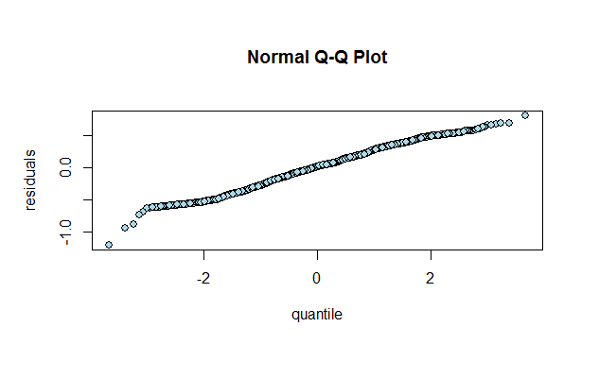
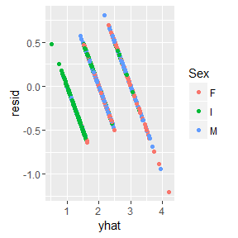
Regression Plot
Residual Vs Predicted Values

Slide 14
Regression Analysis on Age
Call: ## lm(formula = Age ~ Length + Height + Whole.Weight + Rings,data=train_data) ## Coefficients: ## Estimate Std. Error t value Pr(>|t|) ## (Intercept) 0.328216 0.040015 8.202 3.67e-16 *** ## Length 1.346769 0.128544 10.477 < 2e-16 *** ## Height 0.870683 0.340968 2.554 0.0107 * ## Whole.Weight -0.329492 0.029794 -11.059 < 2e-16 *** ## Rings 0.113837 0.001948 58.438 < 2e-16 *** ## --- ## Residual standard error: 0.2703 on 2595 degrees of freedom ## Multiple R-squared: 0.7124, Adjusted R-squared: 0.7119 ## F-statistic: 1607 on 4 and 2595 DF, p-value: < 2.2e-16
## Analysis of Variance Table ## ## Response: Age ## Df Sum Sq Mean Sq F value Pr(>F) ## Length 1 187.548 187.548 2567.2 < 2.2e-16 *** ## Height 1 23.364 23.364 319.8 < 2.2e-16 *** ## Whole.Weight 1 9.184 9.184 125.7 < 2.2e-16 *** ## Rings 1 249.491 249.491 3415.0 < 2.2e-16 *** ## Residuals 2595 189.582 0.073 ## --- 659.169 ## Signif. codes: 0 '***' 0.001 '**' 0.01 '*' 0.05 '.' 0.1 ' ' 1
Analysis of Variance Table Response: Age Df Sum Sq Mean Sq F value Pr(>F) Length 1 249.283 249.283 3686.527 < 2.2e-16 *** Diameter 1 13.364 13.364 197.640 < 2.2e-16 *** Height 1 10.293 10.293 152.211 < 2.2e-16 *** Whole.Weight 1 16.188 16.188 239.391 < 2.2e-16 ** Viscera.Weight 1 4.757 4.757 70.345 < 2.2e-16 *** Shell.Weight 1 45.559 45.559 673.746 < 2.2e-16 *** Rings 1 315.314 315.314 4663.018 < 2.2e-16 *** Residuals 4168 281.840 0.068

Slide 15
Regression Analysis on Gender
Call:
lm(formula = V1.n ~ Length + Diameter + Height + Whole.Weight +
Viscera.Weight + Shell.Weight + Rings, data = d1)
Coefficients:
Estimate Std. Error t value Pr(>|t|)
(Intercept) 3.124158 0.089070 35.075 < 2e-16 ***
Length 1.761206 0.594182 2.964 0.003053 **
Diameter -3.046161 0.733234 -4.154 3.33e-05 ***
Height -1.126478 0.508921 -2.213 0.026920 *
Whole.Weight -0.467484 0.136283 -3.430 0.000609 ***
Viscera.Weight -1.005010 0.409916 -2.452 0.014257 *
Shell.Weight 1.075066 0.314712 3.416 0.000641 ***
Rings -0.038205 0.004729 -8.079 8.48e-16 ***
Residual standard error: 0.7239 on 4168 degrees of freedom
Multiple R-squared: 0.2366, Adjusted R-squared: 0.2353
F-statistic: 184.5 on 7 and 4168 DF, p-value: < 2.2e-16

Slide 16
Linear Discriminant Analysis
ON AGE
ON GENDER
Call: ## lda(Age ~ Length + Diameter + Height + Whole.Weight + Viscera.Weight + ## Shell.Weight, data = gData) ## ## Prior probabilities of groups: ## 1 2 3 ## 0.1073311 0.7755151 0.1171538 ## ## Group means: ## Length Diameter Height Whole.Weight Viscera.Weight Shell.Weight ## 1 0.3214621 0.2405134 0.07934152 0.1987165 0.04262946 0.05736049 ## 2 0.5421872 0.4221501 0.14305684 0.8688054 0.19066559 0.24512573 ## 3 0.5890082 0.4666360 0.16850716 1.1390389 0.23998671 0.36325460 ## ## Coefficients of linear discriminants: ## LD1 LD2 ## Length 7.969149 -15.0665489 ## Diameter 10.311185 -0.7794949 ## Height 16.030201 10.9924667 ## Whole.Weight -3.284777 -2.1906461 ## Viscera.Weight -1.726759 -1.7482654 ## Shell.Weight 2.745354 21.3135980 ## ## Proportion of trace: ## LD1 LD2 ## 0.7939 0.2061
lda(factor(Sex) ~ Length + Diameter + Height + Whole.Weight + ## Viscera.Weight + Shell.Weight, data = gData) ## ## Prior probabilities of groups: ## F I M ## 0.3128893 0.3215141 0.3655966 ## ## Group means: ## Length Diameter Height Whole.Weight Viscera.Weight Shell.Weight ## F 0.5791884 0.4548086 0.1572665 1.0468786 0.23077642 0.3021390 ## I 0.4277459 0.3264940 0.1079955 0.4313625 0.09201006 0.1281822 ## M 0.5613663 0.4392529 0.1511796 0.9909738 0.21544201 0.2819050 ## ## Coefficients of linear discriminants: ## LD1 LD2 ## Length 6.6303085 1.666405 ## Diameter -11.7480211 -11.385199 ## Height -11.1533706 -3.055235 ## Whole.Weight 0.4695207 11.617462 ## Viscera.Weight -5.3058845 -22.681957 ## Shell.Weight -0.9104921 -15.654075 ## ## Proportion of trace: ## LD1 LD2 ## 0.9895 0.0105
## [1] I M I I I M ## Levels: F I M

Slide 17
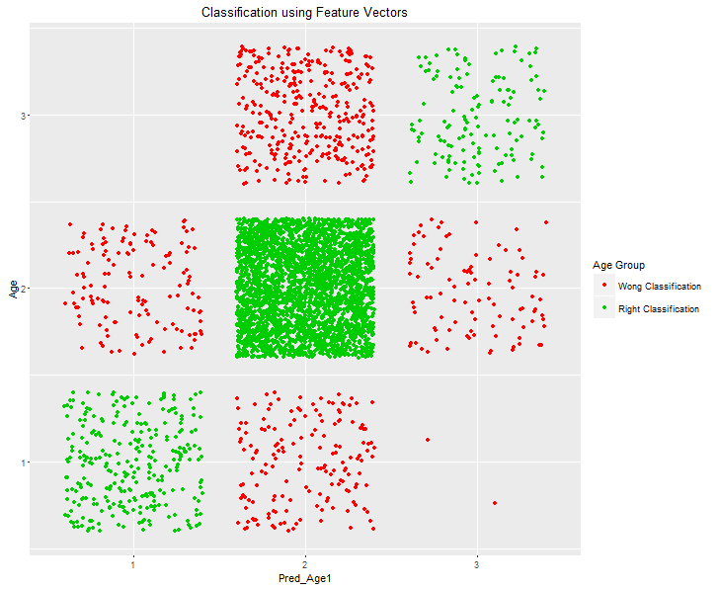
Classification Accuracy

Slide 18
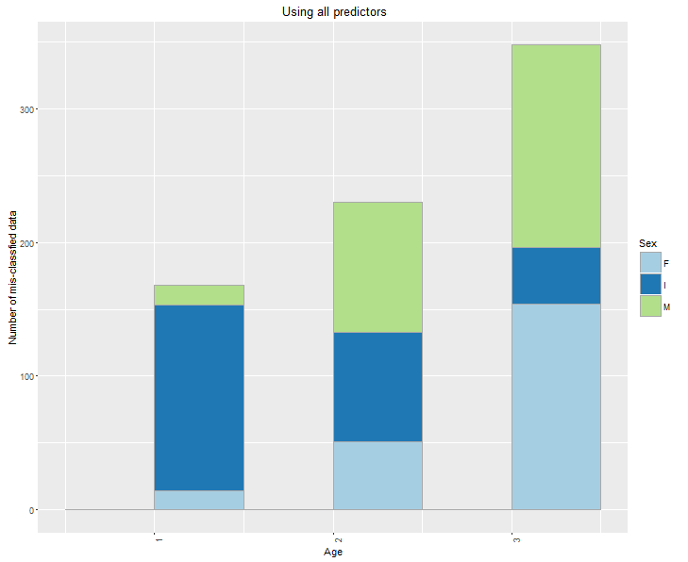
Classified data vs original data

Slide 19
Conclusion
Classification Method | Gender Accuracy | Age Accuracy
SVM Classification | 82.0423 | 55.2817
Naïve Bayes Algorithm | 52.5352 | 78.5915
Linear Regression | 23.66 | 71.24
Linear Discriminant Analysis | 98.95 | 79.39

